Slide 1
Grant Monitor Demo Day
Sprint 2
Daron Adams, Ken Schnarrs, Alex Iliev, Chase Rumfelt
Daron and Sons Software Development Co.

Slide 2

Sprint 2 Goals
Achieved Goals
Meet with our client so that we can find out more about the project and to find out what she is looking for
Make sidebar components link to other relevant pages
Add chart feature such as bar charts and line graphs
Add a feature to download charts as a pdf
Get user authentication working (registration, login, logout)
Settle on a backend to use (Typescript Express backend)
Make sure that Express Typescript backend works for all members
Make sure that Express Typescript backend works with database
Work on making a design of the overall database
Make register and login pages take you to the dashboard (navigation)
Add user context
Finalize database schema
In Progress / Not Completed Goals
Polish up dashboard page and make data come from database instead of being hard-coded
Implement a calendar feature
Work on making wireframes regarding the grants (Editing them, inputting data manually if necessary)
Goals That Were Scrapped
Fix the Initial backend/database issue that we encountered (Completed but .NET was scrapped)
Due to repeated .NET issues, we decided to scrap the initial backend we chose and replace it with a Rails Backend (However, due to an issue with the Rails api we ended up switching to a Typescript Express backend afterwards)

Slide 3
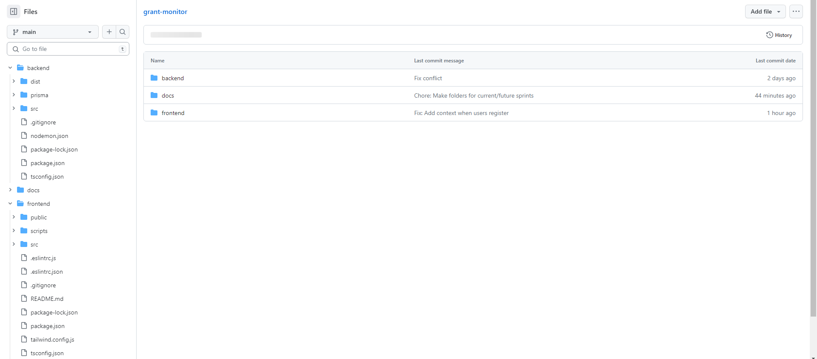
Live Demo of Our Code

Slide 4
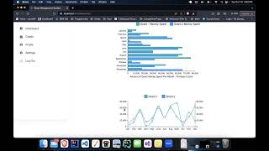
Think Aloud
Feedback from Finch Team
Considering what we had finished by the time the think aloud came around, we think that it went pretty well. The Finch Team mentioned that they did not feel lost while navigating our website and mentioned that one improvement we could make was putting the download button for charts at the top of the page rather than the bottom. From the think aloud, we also saw a small bug with the sidebar links which we were able to fix.
However, for the next think aloud we hope to have more features to show so that we can have more debrief questions to ask and we hope to do a think aloud with our client in addition to the Finch Team.

Slide 5

Sprint 3 Goals
Implement the calendar feature
Work on implementing database design
Work on redesigning dashboard page to use real data
Make charts use real data from the database in order for the charts to be more accurate
Work on the ingesting of forms
Look into which users should be allowed into the website and look into how many users we will actually need to account for
Set up a meeting with our client to show her what we have and to ask her some questions

Slide 6


